Slide 1

Brielle PTO Meeting
March 3, 2022

Slide 2
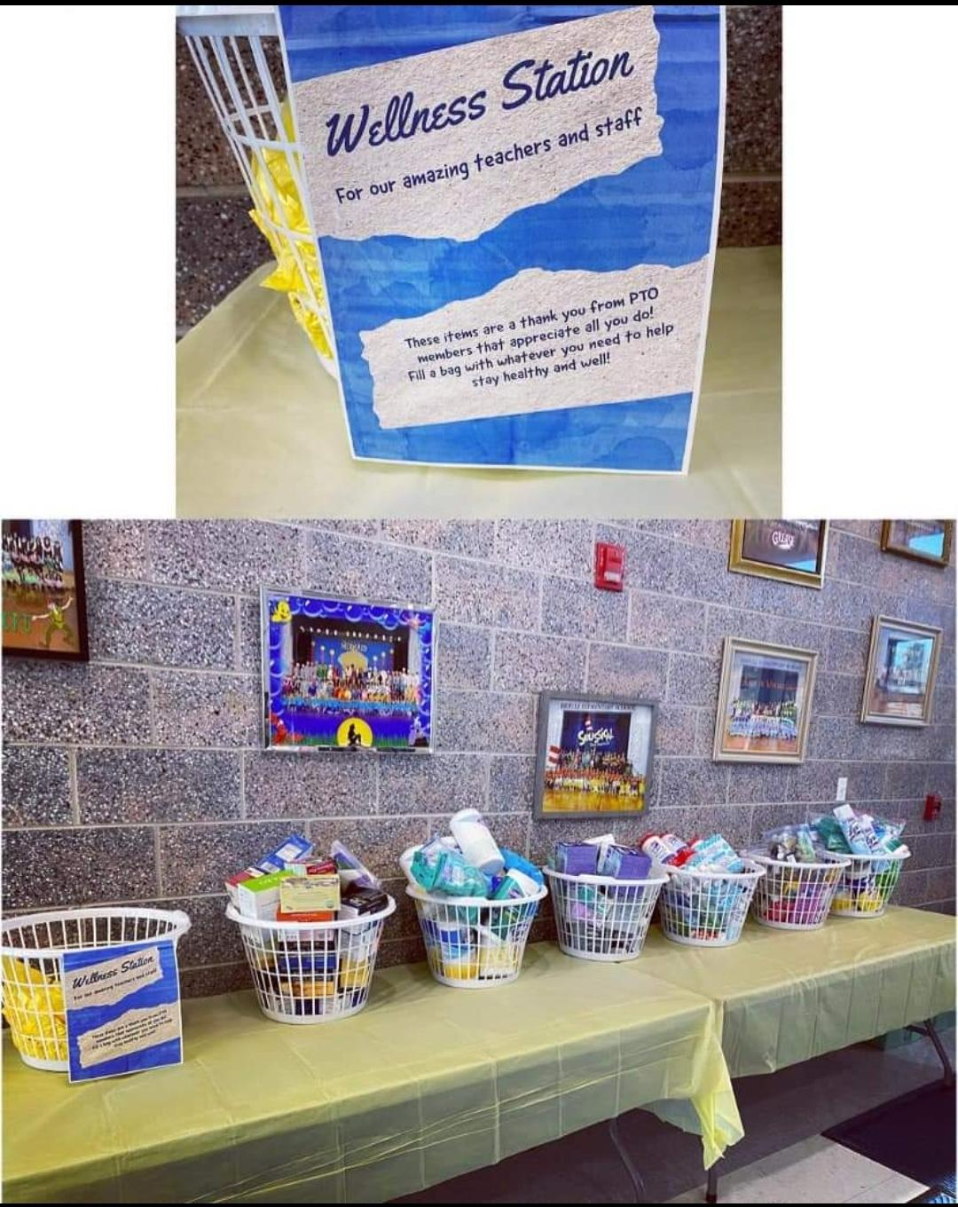
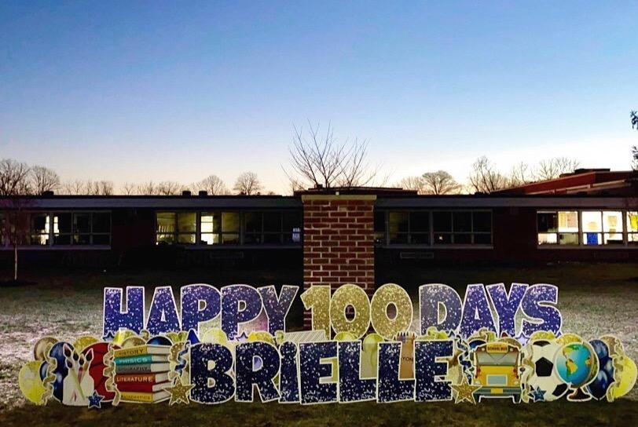
President Report:
Thank you to the committee chairs and volunteers for giving the PTO their time and effort to manage and execute successful events!
A special thank you to the teachers and staff for all they’ve done, especially during this last spike with Covid. The PTO requested donations to help supply the teachers with wellness items. Thank you to everyone who donated!
The PTO sponsored a lawn sign to help celebrate the 100th day of school!

Slide 3
President Report:
Bylaw changes:
  Merging both the Program and Enrichment Officer and Hospitality Officer under the responsibilities of the Co-President position.
  Merging the Publicity Officer with the Secretary position.
  Merging Membership Officer with the Vice President position.
  Terms will now be up to two years per board position.
  General meetings must take place a minimum of 3 times per school year.
  Membership year will now be August to July

Slide 4
Treasurer Report:
Account Balances:
  Main
  Class 2022
  Class 2023
  Class 2024

Slide 5
Principal Report

Slide 6
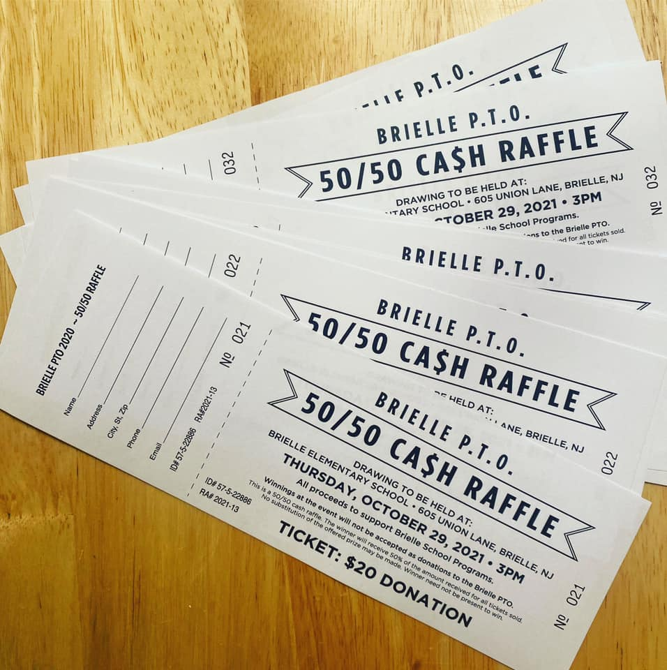
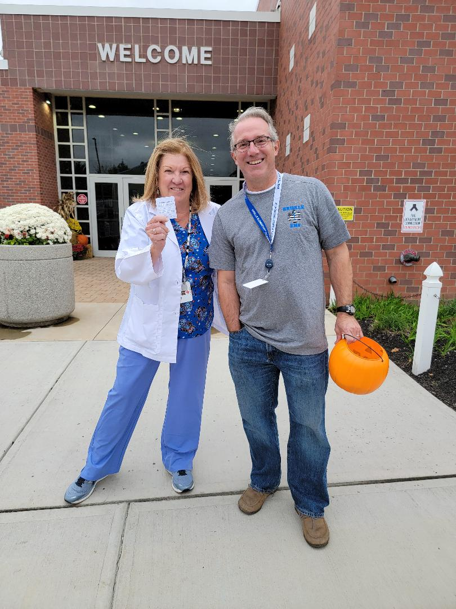
50/50 Raffle Tickets
Committee Chair – Kayte Keller
  Total of 816 tickets sold for a grand total pot of $16,320 with a net proceeds of $7,995.
  Winning ticket pulled on October 29th by Mrs. Carlson, and the winner was…..
  Ellen Viscelglia - CONGRATULATIONS!

Slide 7

Spiritwear Sale
Committee Chair - Kayte Keller
  Sale ran from November 1st - 13th
  Total sold was $4,517, with the PTO profiting $644.
  Teacher Spiritwear sold a total of $380 with the PTO profiting $40.

Slide 8

Wine and Wear
Held on November 4th at Darcy Park Boutique & Styled Strong Fitness, Manasquan
15% of total sales donated
Total profit $347

Slide 9
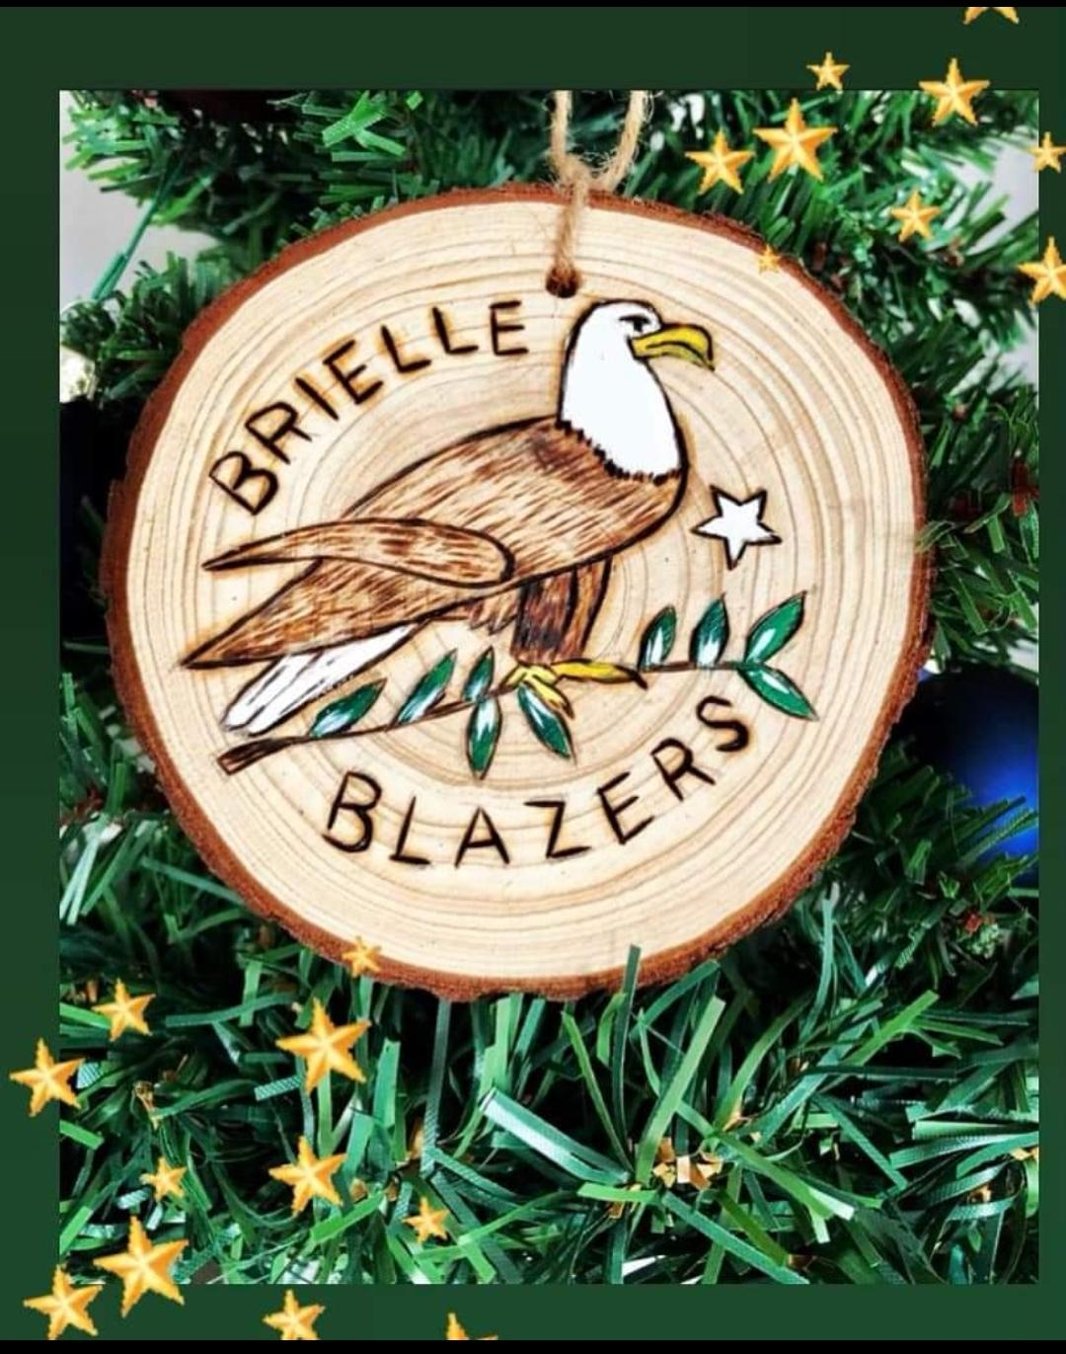
Brielle Blazers Ornaments
Sale from November 15th - 24th
Sold 39 ornaments at $24 each
Total profit $312

Slide 10
Giving Tree:
Committee Chair - Stacy McDaid
  Through donations, gifts are provided to local families, as well as all siblings and/or children currently living in the household of families that may be struggling or experiencing financial difficulties.
  All gifts are generously donated by members of the school community.
  8 families participated in the program with a total of 24 children receiving gifts
  A total of 120 gifts and/or gift cards was provided - including a Shoprite gift card for each of the 8 families
  Each family was extremely grateful and appreciative of the assistance!

Slide 11
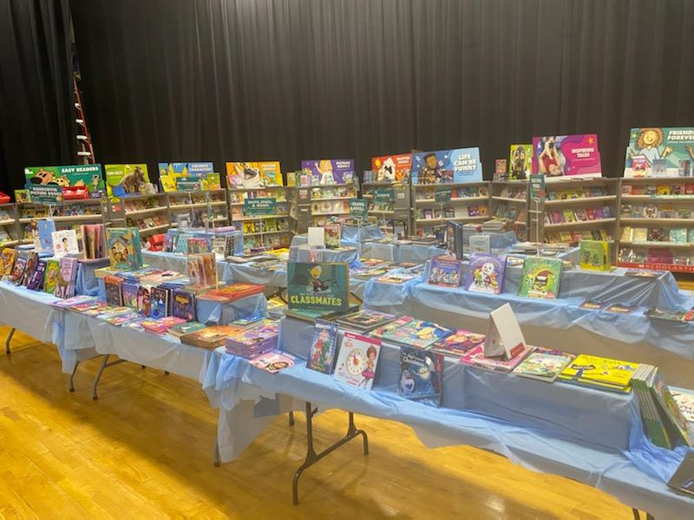
Book Fair
Committee Chairs - Tara Healey, Kelly Hadell
  Week of November 29th - December 4th
  Using scholastic dollars earned of $2041.82, all classroom teachers received 8 - 12 books for their classroom libraries.
  The next book fair is scheduled for May 31th - June 3rd

Slide 12
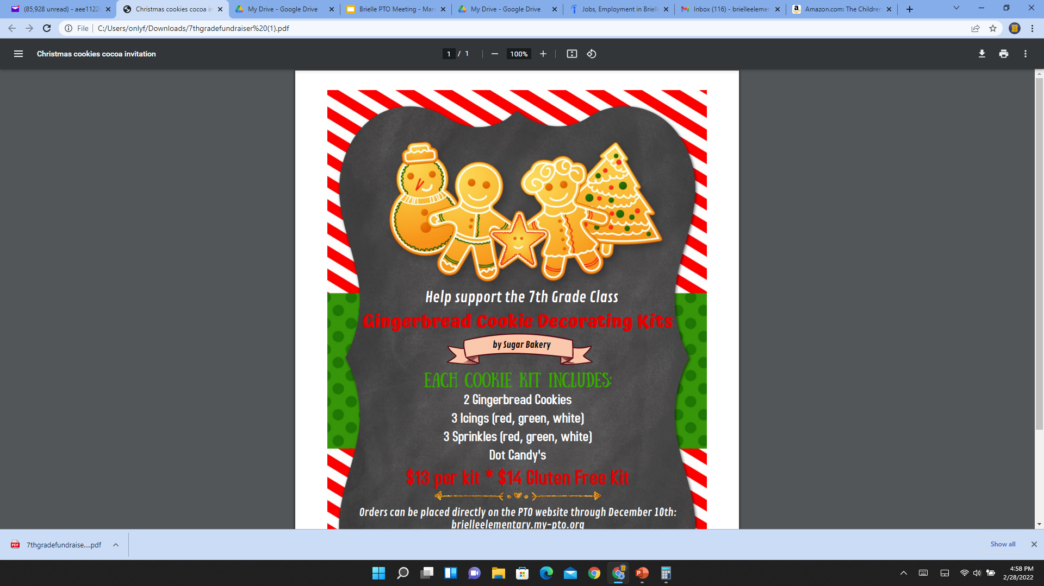
7th Grade Gingerbread Cookie Fundraiser
Committee Chairs - Mishelle Whiting, Traci Moretti, Nancy Atnes
  Total of 111 cookie kits sold
  Total profit $1,290

Slide 13
Winter Enrichment
Committee Chair - Beth Catania and Terri DeMarco
  5 Classes offered with options for grades K-8 - Ahoy Matey, Art-O-Motion, Cartooning, Cook With a Book, Cryptocurrency Club
  Students have the opportunity to learn more about pirates, cooking, art, and finances in these hour long classes once a week.
  A total of 64 students signed up
  Total profit $2,378.17
  Spring Enrichment is March 29th - May 12th (information and signups will be sent out next week)
  We look forward to more great programs in the future, and we were glad to get some programs back after a hiatus.

Slide 14
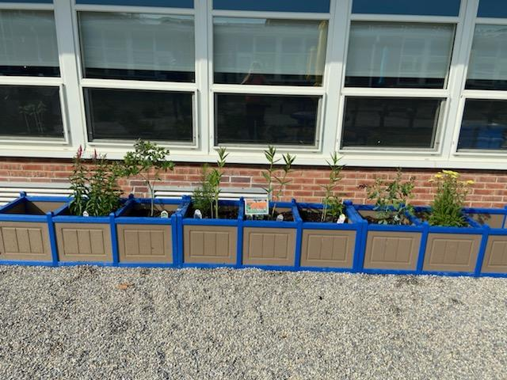
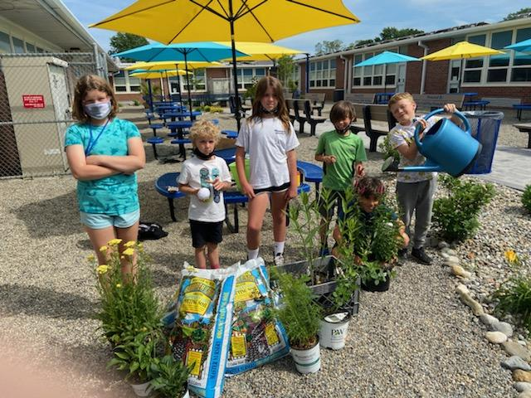
Eco Enrichment Committee
Committee Chairs - Maren Clayton, Lori Garrabrant, Susan Dolan
  Objectives: - Connect students to nature and inspire an ethic of environmental stewardship (e.g., pollinator garden)
  Restore biodiversity on school grounds (e.g., no mow zone) - Challenge students to find solutions to Climate Change issues (e.g., Earth Week Challenges)
  Encourage student environmental leaders (e.g., Eco Enrichment Class/Eco Club).
  Gain recognition for environmental efforts and share stories about sustainability projects (e.g., Certified Native Schoolyard Habitat Site (NWF)
  Leave a legacy for future generations (.e.g., class tree plantings)
Native Plant & Pollinator Garden (Spring 2021)
Upcoming Projects (Spring 2022):
Earth Day (April 22)/Earth Week at BES
Eco Class (Spring Enrichment) taught by Mr. Yee
“No Mow Zone” & Wildflower Meadow
Tree Planting/Replace rapidly aging trees at BES (Arbor Day is April 29)

Slide 15

Box Tops
As of today $178.80 earned from July 2021
Accrual year from July ‘21 to June ‘22
Example of how to scan a receipt

Slide 16
New Business - Upcoming Events
Boys Event | Lilly Smith |  | April 1, 2022 | Now TBD
Enrichment - Spring | Beth Catania | Terri DeMarco | March 29, 2022 | May 12, 2022
Earth Week | Maren Clayton | Suzanne Donlan | April 11, 2022 | April 14, 2022
Teacher Appreciation Week | Kendal Porter | Julie Obara | May 2, 2022 | May 6, 2022
Plant Sale | Kathy Olson |  | May 6, 2022
Field Day Shirts | Brooks Morris
Book Fair - Spring | Tara Healey | Kelly Hadell | May 31, 2022 | June 3, 2022
Missoula Theater Week | Catherine Ugolini |  | May 2, 2022 | May 7, 2022

Slide 17
New Business
New Committee Chairs for ‘22 - ‘23 school year
  Kindergarten Orientation
  Kindergarten/New Student/Family Tea
  Welcome Back Breakfast
  8th Grade Bake Sale (Brielle Day)
  Enrichment
  6th Grade Ice Cream Social
  Giving Tree
  Book Fair
  7th Grade Pancake Breakfast
  Restaurant Night
  Boys Event
  Cinderella Ball
  Earth Week
  Teacher Appreciation Week
  Plant Sale
  Field Day Shirts
  Missoula Theater WEek
  Year-End Gifts for Front Office & Custodians

Slide 18
Next Meetings
May 18, 2022 - 7:00 pm

