Slide 1
Brielle PTO Meeting
November 30, 2023

Slide 2
Treasurer Report:
Account Balances:
Main - $62,605.14
Class 2024 - $9.945.25
Class 2025 - $5,576.53
Class 2026 - $2,343.50

Slide 3
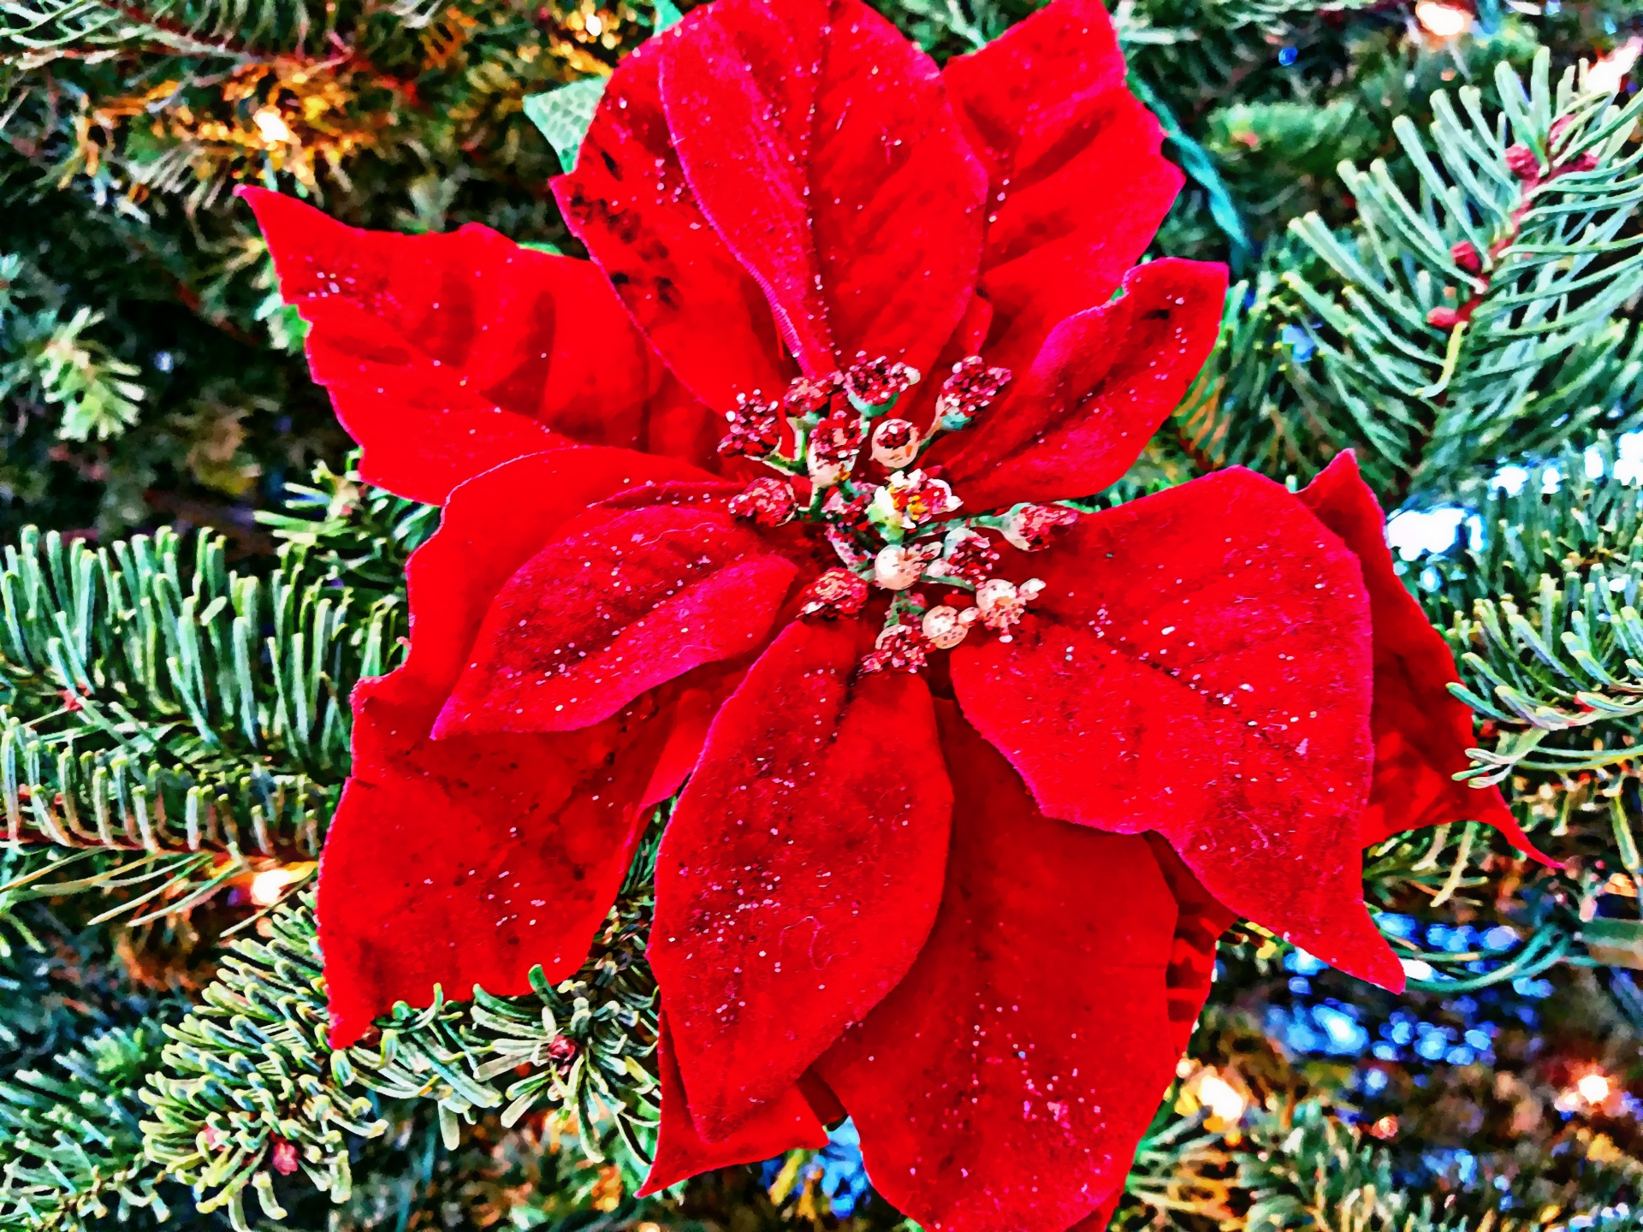
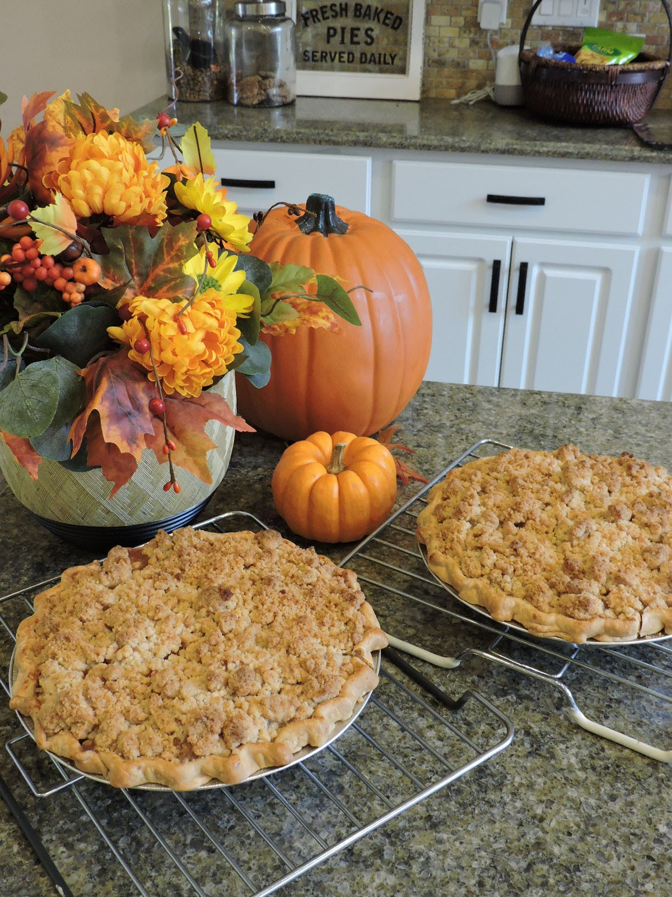
8th Grade Sales
Mueller’s Pie Sale
Jackie Amorelli, Kelly Amore & Carly Immen
261 Pies
139 Crumb Cakes
Profit of $1,961
Poinsettia and Wreath Sale
Kathy Olson & Kelly Buckle
Pickup on December 8th
Profit $1,261
This Photo by Unknown Author is licensed under CC BY-NC-ND

Slide 4
Teacher Grants
The following have been approved:
Tara Healey - $1,500 for an indoor sensory path
Tara Healey - $1,400 for an outdoor sensory path
Tim Prol & Sydney Rosen - $139.90 for ukulele tuners
Cheryl Shaak - $1,074.00 for sorting bins for math and ELA
Anthony Mahon - $875 for wireless presentation remotes
Anthony Mahon - $59.88 for Gimkit Pr0
Total for grants= $5,048.78

Slide 5
Principal Report

Slide 6
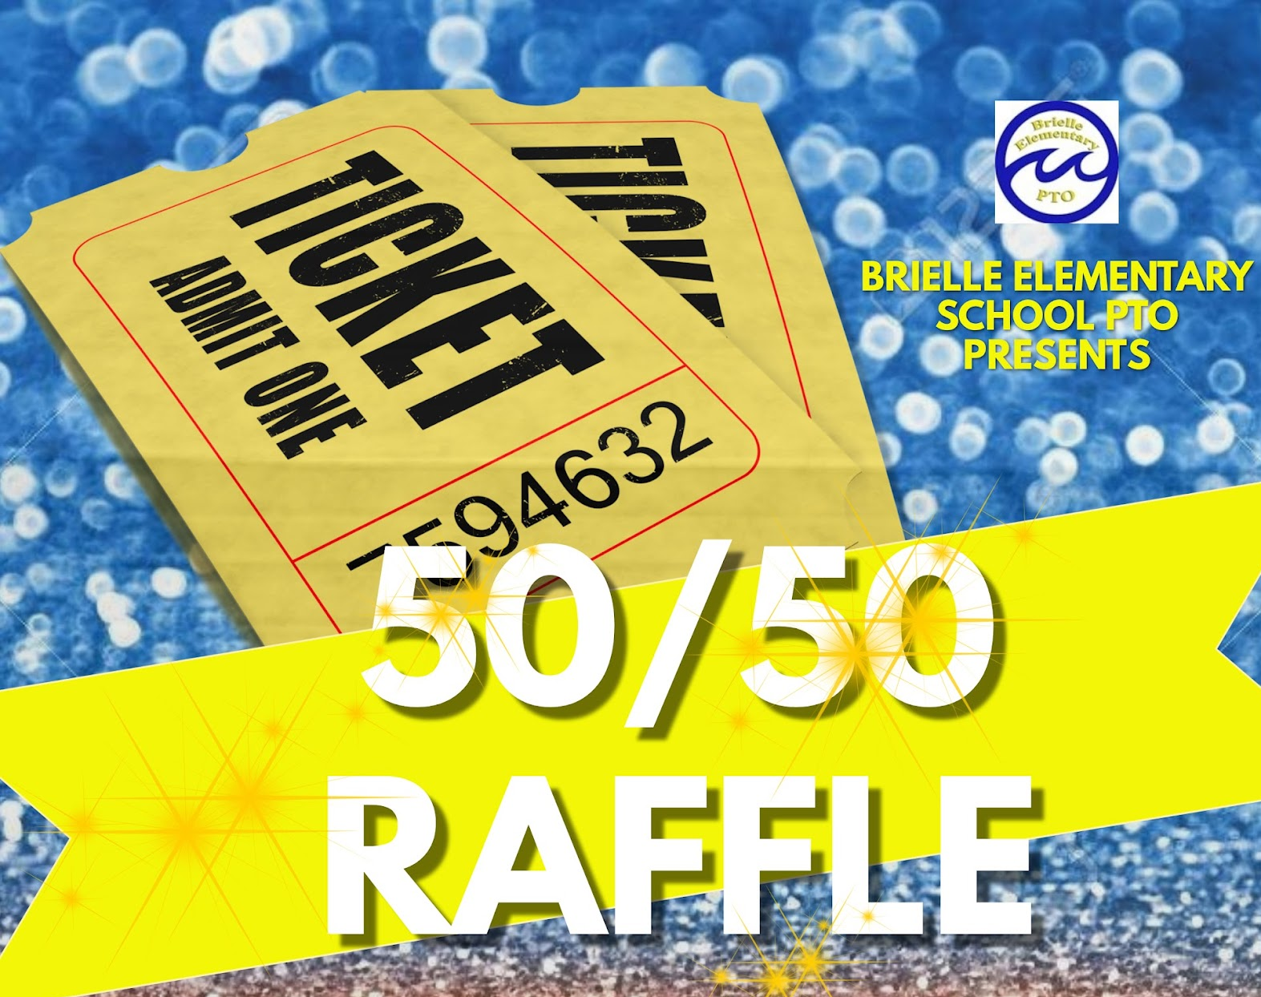
50/50 Raffle Tickets
Total of 716 tickets sold for a grand total pot of $14,320 with a net proceeds of $7,160.
Winning ticket pulled on October 27th by Mrs. Poelstra, and the winner was…..
Maureen Dempsey - CONGRATULATIONS!

Slide 7
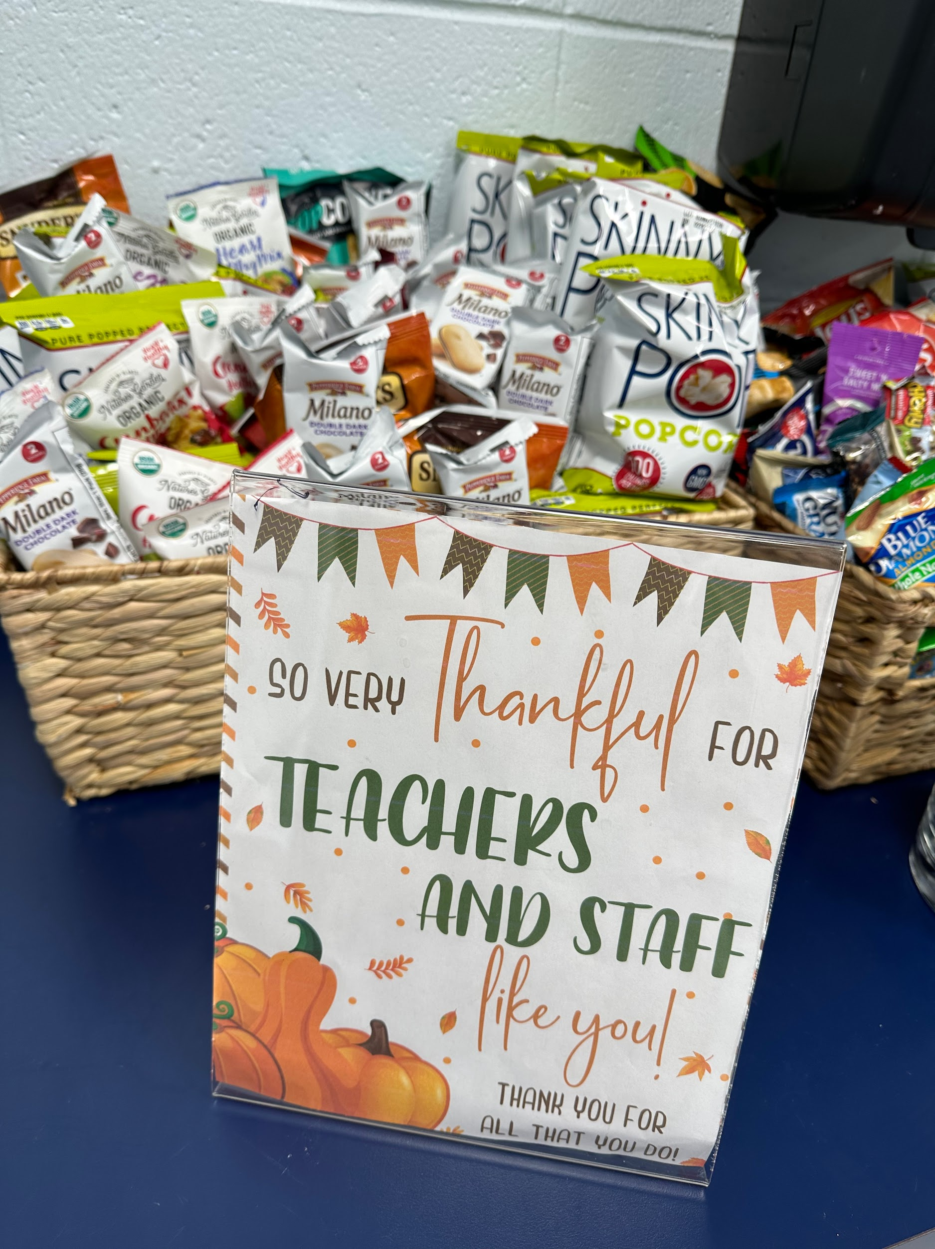
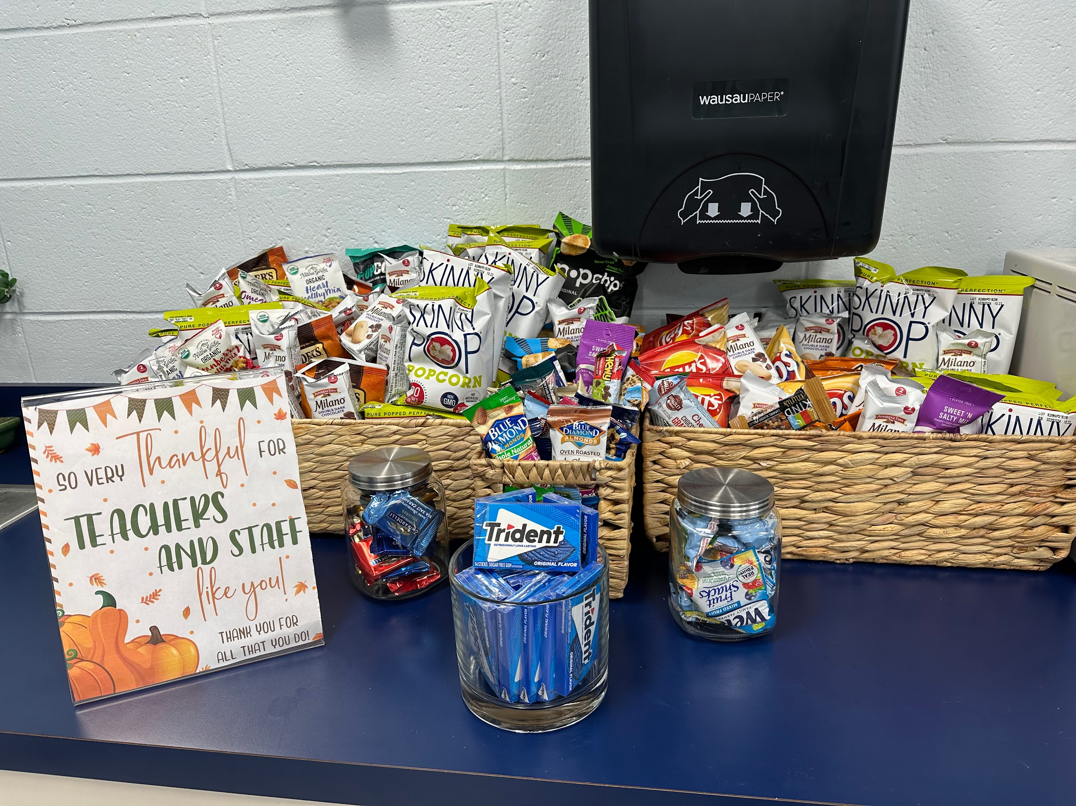
Stock the Teachers Lounge
Great Response from 8th and 7th grade so far!
December- 6th Grade
January - 5th Grade
February - 4th Grade
March - 3rd Grade
April - 2nd Grade
May - 1st Grade
June - K & Preschool
Class parents send reminder each month
Donations dropped off to main office first week of the month

Slide 8
Fall Enrichment
9 Classes offered with options for grades K-8 – Bracelet Making, Cook with a Book, Crafts, Board games, Eco class, Pokemon & Backgammon
Teachers received $100 gift card in addition the hourly rate
Winter Enrichment is January 16th - February 29th (information and signups will be sent out next week)

Slide 9
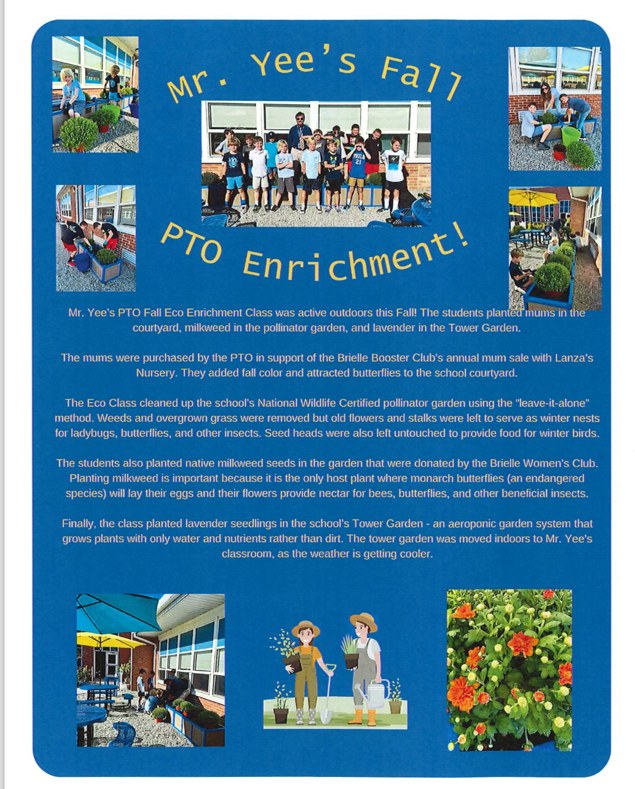
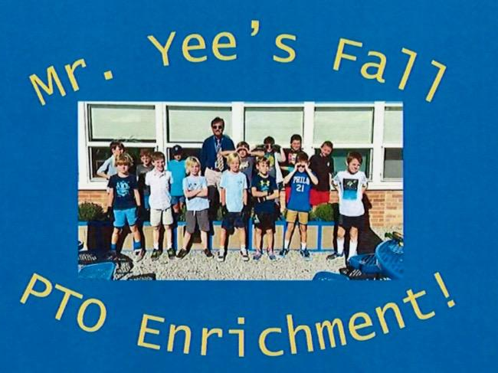
Eco Enrichment Committee

Slide 10
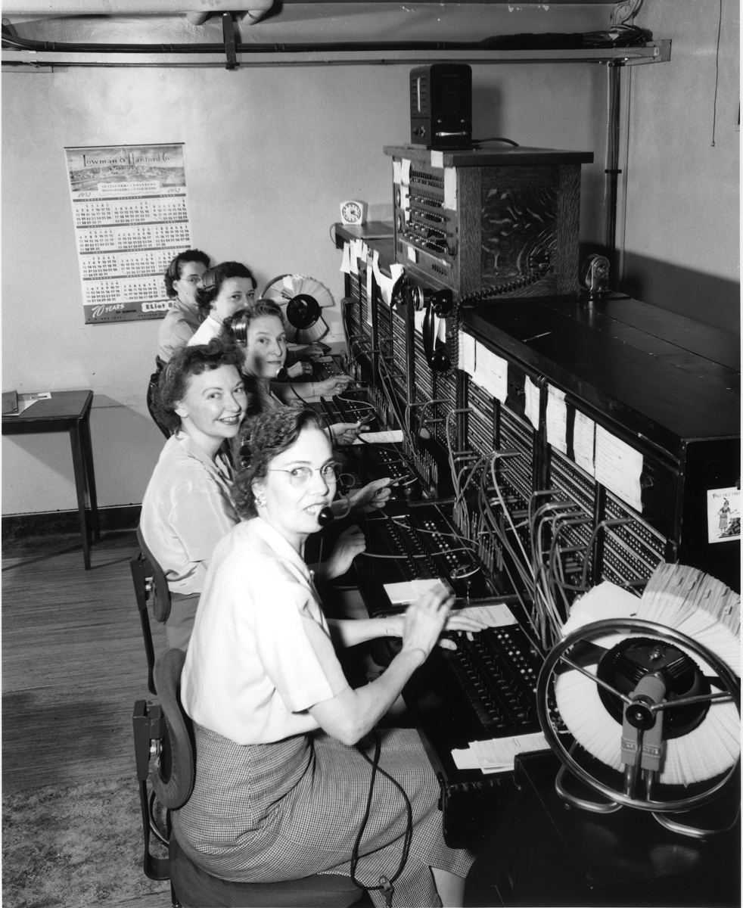
Class Parents
Old school creating a phone chain!
Point person for each grade and they will share with other grade level class parents who will share with their respective classes. Email or texting… whichever works for you!
Pre- K- 1st- 2nd- 3rd- 4th- 5th- 6th-
7th- 8th

Slide 11
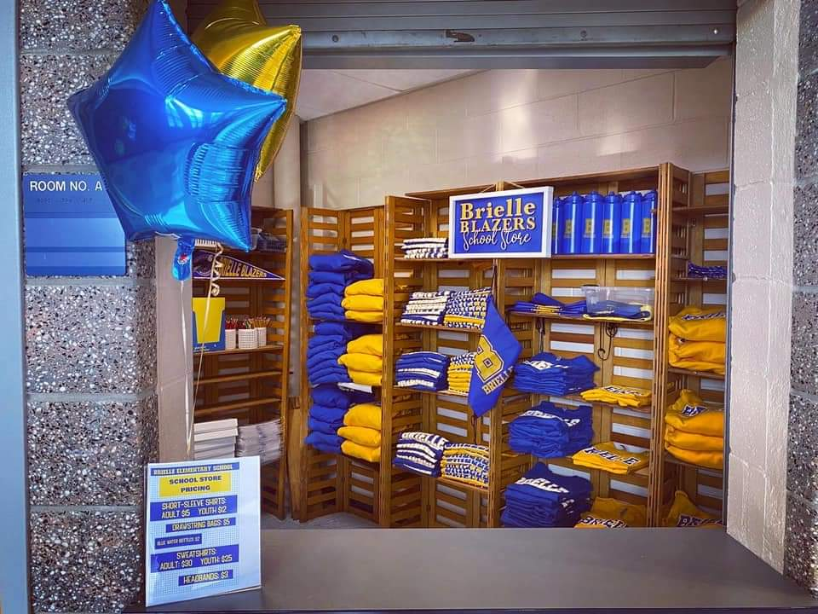
School Store
Committee Chair - Tamara Christiani
School store is expected to be open during the year Mon-Thur 3-3:20
All students are welcome, even if they exit another door, come to the main lobby after pick up.
Select Spiritwear items sold
Snacks and drinks also offered

Slide 12
New Business - Upcoming Events
Breakfast with Santa – Dec 2
Winter Spirit Wear Sale
Giving Tree – Sign up Genius
Book Fair - Now
Candy Cane My Yard – week of December 18th - Volunteers needed!
Family Bingo – Chairs needed January 25th
Snowball Dance – January 12th
Girls Dance – February 23rd
Boys Event – March 15th

Slide 13
Next Meetings
February 8th, 2024 - 7:00 pm
April 11th, 2024 – 7:00 pm

